Slide 1
TSX: CEK.TO
WWW.CASPIANENERGYINC.COM
January 2012

Slide 2
Cautionary Statement
The information contained in this presentation has been prepared by Caspian Energy Inc. (the “Company”) and is subject to updating, revision and amendment. While this information has
been prepared in good faith, no representation or warranty, express or implied, is made as to the fairness, accuracy, completeness or correctness of the information and opinions
contained in this presentation and no reliance should be placed on such information or opinions. Neither the Company nor any of its affiliates, directors, officers or employees nor any
other person accepts any liability whatsoever for any loss, howsoever arising, from any use of such information or opinions.
This presentation is presented for informational purposes only and is not and in no circumstances is to be construed as an advertisement or an offer to sell or an invitation to purchase or
subscribe for any securities of the Company and should not be relied upon in connection with any decision to purchase any securities of the Company.
This presentation is only being provided to persons, and may otherwise only be viewed by persons, in the United Kingdom who fall within the exemptions contained in Articles 19 or 49 of
the Financial Services and Markets Act 2000 (Financial Promotion) Order 2005 and persons who are otherwise permitted by law to receive it (together, “relevant persons”). Any person who
is not a relevant person should not rely on the presentation or its content. If you are not a relevant person, you should not attend the presentation (or otherwise view the presentation), and
should immediately return any materials relating to the presentation currently in your possession. No information made available to you in connection with the presentation may be
passed on, copied, reproduced or otherwise disseminated to any other person.
Certain statements contained in this presentation constitute “forward-looking statements”. Forward-looking statements relate to future events or the Company's future performance. All
statements other than statements of historical fact may be forward-looking statements. Forward-looking statements are often, but not always, identified by the use of words such as
“seek”, “anticipate”, “budget”, “plan”, “continue”, “estimate”, “expect”, “forecast”, “may”, “will”, “project”, “predict”, “potential”, “targeting”, “intend”, “could”, “might”, “should”,
“believe” and similar words suggesting future outcomes or statements regarding an outlook. Forward-looking statements in this presentation include, but are not limited to, statements
with respect to: the performance characteristics of the Company’s oil and natural gas properties; drilling plans and the timing and location thereof; plans for the exploration and
development of the North Block, plans for seismic acquisition and surveys; production capacity and levels, and the timing of achieving such capacity and levels; the size of oil and natural
gas reserves; projections of market prices and costs; supply and demand for oil and natural gas; expectations regarding the ability of the Company to raise capital and to add to reserves;
and capital expenditure programs. Statements relating to “reserves” are deemed to be forward-looking statements, as they involve the implied assessment, based on certain estimates
and assumptions, that the reserves described can be profitably produced in the future.
Forward-looking statements involve known and unknown risks, uncertainties and other factors that may cause actual results or events to differ materially from those anticipated in such
forward-looking statements. The Company believes the expectations reflected in the forward-looking statements contained in this presentation are reasonable but no assurance can be
given that these expectations will prove to be correct and readers are cautioned not to place undue reliance on forward-looking statements contained in this presentation. Some of the
risks and other factors which could cause results to differ materially from those expressed in the forward-looking statements contained in this presentation include, but are not limited to:
volatility of oil and natural gas prices; liabilities inherent in oil and natural gas operations; uncertainties associated with estimating oil and natural gas reserves; competition for, among
other things, capital, acquisitions of reserves, undeveloped lands and skilled personnel; geological, technical, drilling and processing problems; drilling and testing results, fluctuations in
currency and interest rates; product supply and demand; risks inherent in the Company’s foreign operations; changes in environmental and other regulations or the interpretation of such
regulations; political and economic conditions in the Republic of Kazakhstan; and the other factors discussed in this presentation and in the Company’s filings with Canadian securities
regulatory authorities which are available to the public at www.sedar.com. You are cautioned that the foregoing lists of factors are not exhaustive. The forward-looking statements
contained in this presentation are made as at the date hereof and the Company undertakes no obligation to update publicly or revise any forward-looking statements contained in this
presentation or in any other documents filed with Canadian securities regulatory authorities, whether as a result of new information, future events or otherwise, except in accordance with
applicable securities laws.
The information and opinions presented in this presentation are provided as at the date of this presentation (or such other date indicated) and are subject to change without notice. The
Company does not undertake or agree to provide the recipient of this presentation with access to any additional information or to update this presentation or to correct any inaccuracies
in, or omissions from, this presentation of which it may become aware.
Reserve estimates contained in this presentation have been prepared by McDaniel & Associates in accordance with National Instrument 51-101 - Standards of Disclosure for Oil and Gas
Activities of the Canadian securities regulatory authorities. Certain natural gas volumes indicated in this presentation have been converted to barrels of oil equivalent (“BOE”) in the ratio
of six thousand cubic feet of gas to one barrel of oil (6 Mcf: 1 bbl). BOEs may be misleading, particularly if used in isolation. A BOE conversion ratio of 6 Mcf: 1 bbl is based on an energy
equivalency conversion method primarily applicable at the burner tip and does not represent a value equivalency at the wellhead.
All information contained in this presentation, including all forward-looking statements, is expressly qualified by this cautionary statement.
TSX: CEK.TO
WWW.CASPIANENERGYINC.COM

Slide 3
Contents November 2011
Page Title
4 Our Status in Kazakhstan
5 “The North Block”
6 Caspian’s Origin
Aral’s New Structure
APC – “ Under New Management”
9 2011-Drilling renewed in North Block
10 East Zhagabulak Field
11 ——— “——— Well #308 – Success is significant
12 ——— “——— Reason for confidence “Location and Geology”
13 ——— “——— “Not a Huge Field But it Has Significant Value for Caspian”
14 ——— “——— Value Sensitivity to Brent Price
15 West Zhagabulak
16 ——— “——— /Sakramabas
17 Greater Zhagabulak – I, II, III, IV, V
18 Work Program
19 Beyond Greater Zhagabulak
20 Baktygaryn
21 Caspian Energy Inc. Net Present Value
22 Caspian Share Price History (2 yr)
23 Why Caspian
24 Appendix – Connections to Market
25 Appendix – Aral Y-T-D Daily Oil Production
26 Appendix – Reasons for Confidence
TSX: CEK.TO
WWW.CASPIANENERGYINC.COM

Slide 4
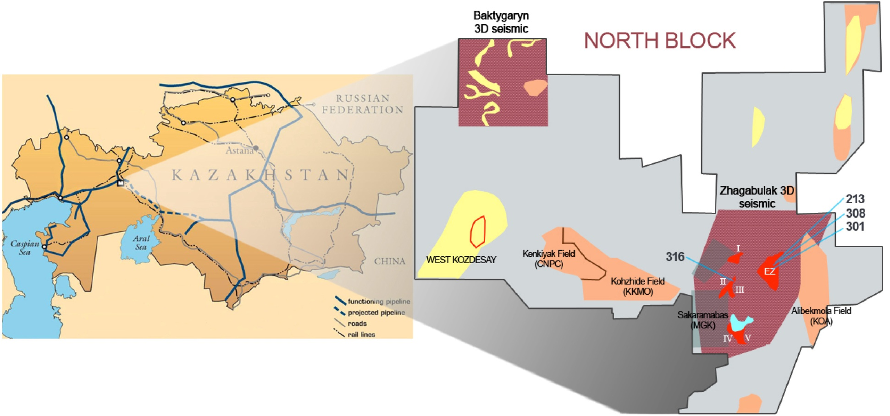
Our Status in Kazakhstan
“The North block”
A 25-year production contract in 2010 with Ministry Oil & Gas
Over 600 km² of 3-D Seismic shot
A new partner with cash strength
Old
Pre Caspian
Basin
CNPC 42,000 BoPD
3-D Seismic
Not Owned by APC
Zhanazhol 94,000 BoPD
(CNPC) Gas 3.3 bn.m³/year
TSX: CEK.TO
WWW.CASPIANENERGYINC.COM

Slide 5
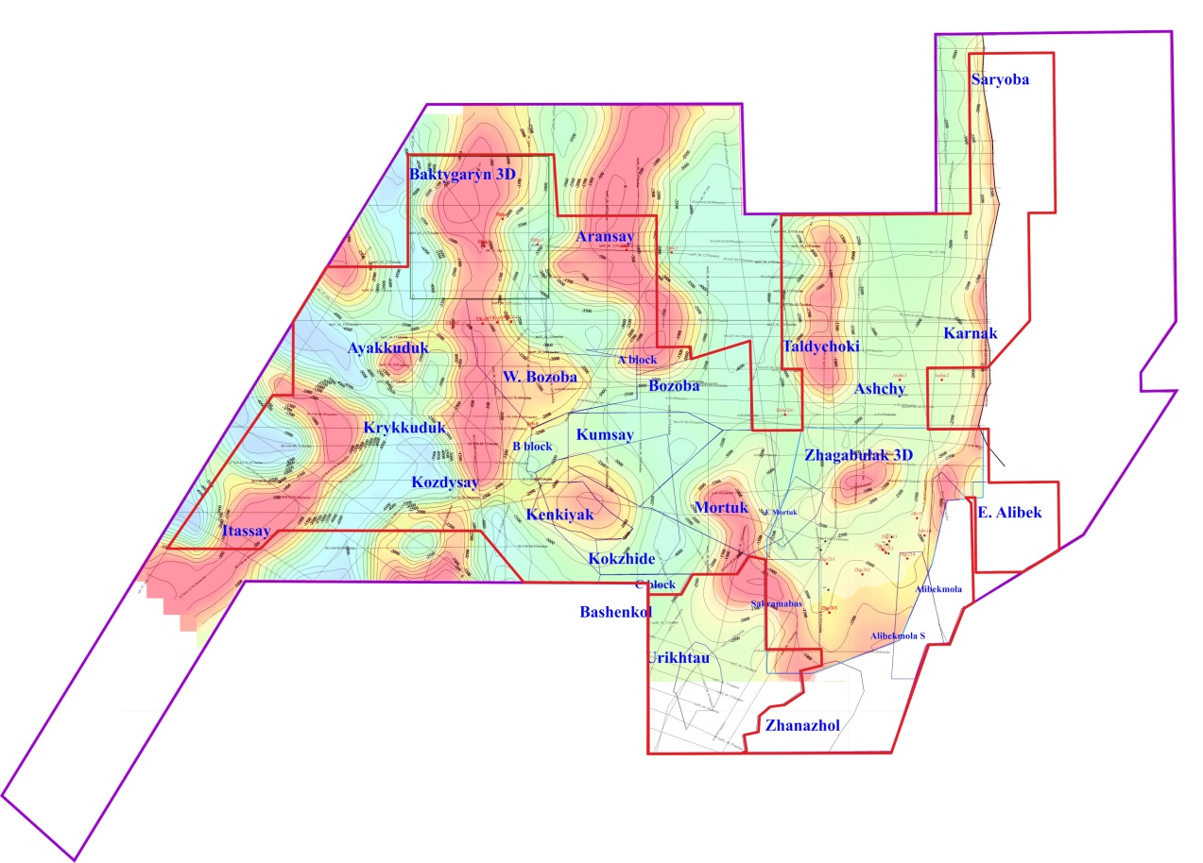
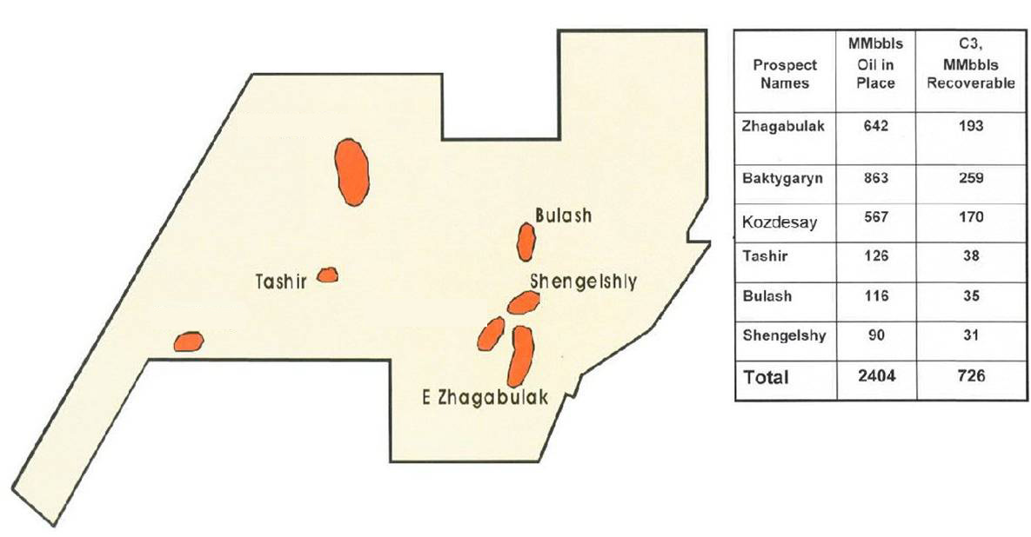
“The North Block”
Government pre-salt reserves Estimates
TSX: CEK.TO
WWW.CASPIANENERGYINC.COM

Slide 6
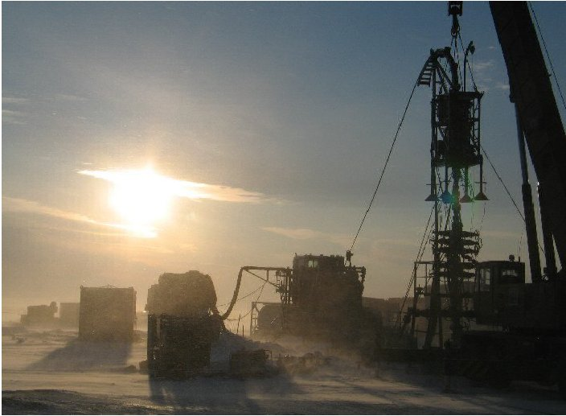
Caspian's Origins
TSX listing in 2004
50/50 partnership with Azden Management since 2004
Together with Azden, CEK owns Aral Petroleum Capital, license holder for 100%
of the North Block
Two producing wells drilled
25-year production contract granted
■
■
■
■
AZDEN
CEK
50%
50%
APC
TSX: CEK.TO
WWW.CASPIANENERGYINC.COM

Slide 7
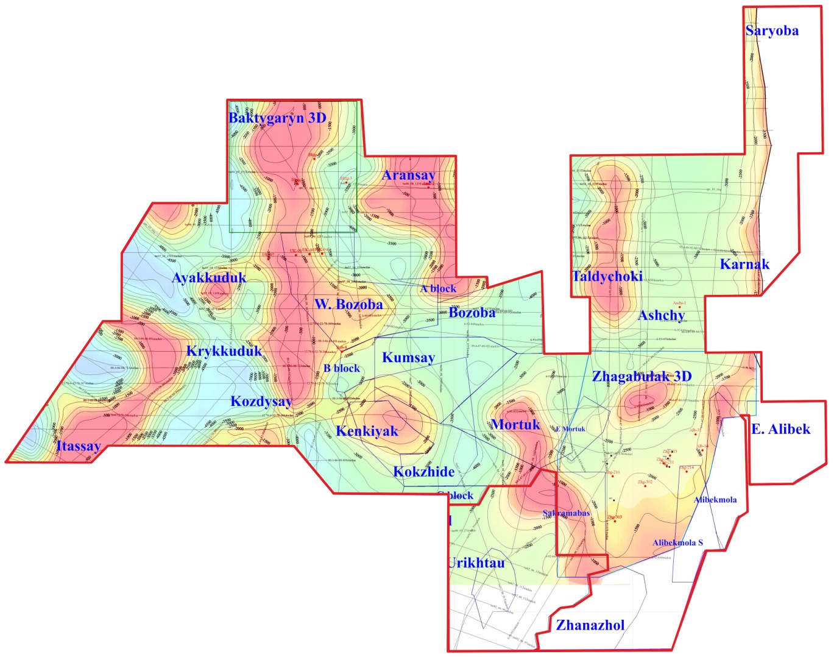
Aral’s New Structure
Aral Petroleum 100%
New Structure
Caspian 40% / Asia
Sixth Energy 60%
WWW.CASPIANENERGYINC.COM
Original Structure -
Caspian 50% / Azden
Management 50%
TSX: CEK.TO
100% of North Block
Azden sells out for us$50 mln us$20 mln upfront balonce paid when production targets are met
CEK “carried” for us$80mln. Capex
CEK us$ 2mln loan on closure
+ us$ 2mln - 12 mths
+ us$ 2mln - 24 mths

Slide 8
APC – “ Under New Management”
Erbolat Kulumbetov - Director – General
35 years management experience in Kazakhstan oil industry. Recently joined APC
Asia-Sixth Energy - US$ 6.7 million cash invested to date
- Six new wells to be drilled
- operational involvement since June, mgt. team in-situ
- 200 km² x-3D Seismic reprocessed by UNIWE – Beijing
- Well 213 work-over
- Contracted x2 drilling rigs
- Commenced drilling of well 308 and 316 in July 2011
- ——— “ ——— well 306 in January 2012
Strategy - Develop East Zhagabulak Field
- Implement a Drilling Campaign throughout North Block
TSX: CEK.TO
WWW.CASPIANENERGYINC.COM

Slide 9
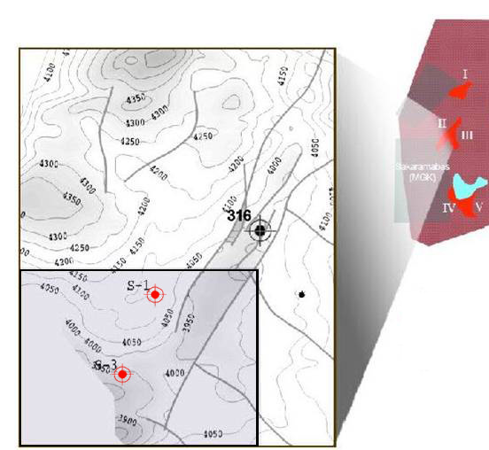
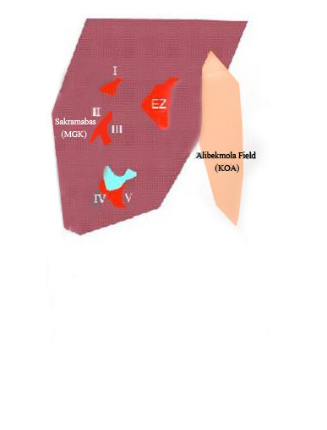
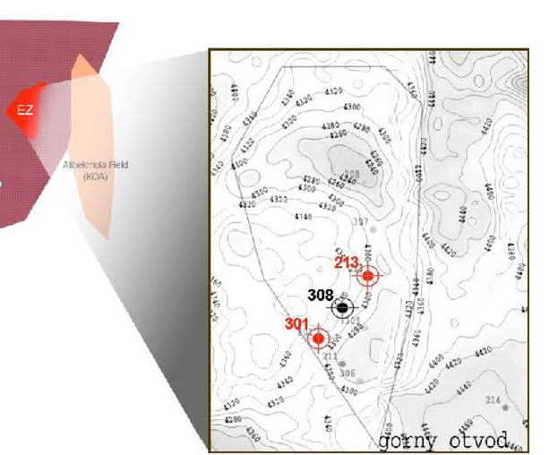
2011-Drilling renewed in North Block
Focus on Greater Zhagabulak
EZ #301 resumes flowing at 330-350 bpd
July - workover EZ #213
- now flowing 200+ bpd
Spudded 15 July EZ#308
Spudded 26 July SAK#316
■
■
■
Greater Zhagabulak
East Zhagabulak
WWW.CASPIANENERGYINC.COM
Sakramabas
TSX: CEK.TO

Slide 10
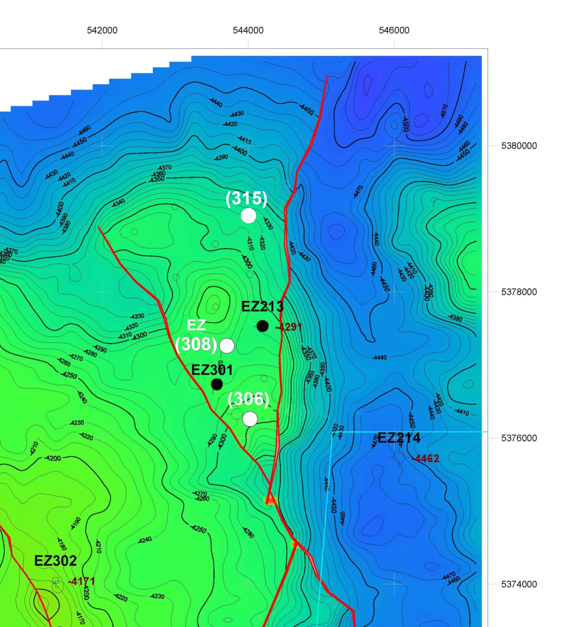
East Zhagabulak Field
[Bashkirian@4,260m]
25 year production contract
“Producers” well 213
well 301
Preparing to test well 308
Spud Jan. well 306
Approved well 315
Full Field Devl. 8 wells
Gross Reserves
2-P = 7.⁶ mmbbls
3-P + Possible = 17.⁹
Scale 1 cm = 554m
TSX: CEK.TO
WWW.CASPIANENERGYINC.COM
Notes:
10
As of now, we’ve drilled two successful wells in the East Zhagabulak field and on the strength of that success, we hold a 25 year production licence for that field, represented on our map as the dark red EZ block. Those wells are now producing a combines total of about 470 barrels of oil per day.
We’re also midway through a three-year exploration licence for the entire grey area, some 1,500 acres called the North Block.
And the North Block is located in West Central Kazakhstan, very near a major oil transmission corridor, so we have ready access to transportation for production volumes well in excess of our current totals.
Despite all this, we were badly delayed in executing our developments plans because of the need of a new partner with deeper pockets.
Fortunately, we found that partner late last year and we are now back in action. In addition to cash strength, our new partner brings a wealth of technical expertise. Taken all together this means that we’re in a very much better position to assess seismic data, drill wells and produce oil than we were a few months ago.

Slide 11
Well #308 – Success is significant
“Operational Transformation”
APC y-t-d 30 Sept.
(A) “if” Well #308
Av. Prod BoPD 402 1,000 1,500
Monthly 1.21 3.02 4.67
Rev us$ ml
Field 62.53 72.47 75.04
netback/bbl us$
G&A/bbl us$ 11.29 3.61 2.79
Monthly $80,000 $720,000 $1.239m
Free Cash Flow
₀º₀ 308 = $ 15 m F/CF
3-P
2-P
East Zhagabulak Field – [Bashkirian@4,260m]
Scale 1 = 50,000
TSX: CEK.TO
WWW.CASPIANENERGYINC.COM
Notes:
11
As of now, we’ve drilled two successful wells in the East Zhagabulak field and on the strength of that success, we hold a 25 year production licence for that field, represented on our map as the dark red EZ block. Those wells are now producing a combines total of about 470 barrels of oil per day.
We’re also midway through a three-year exploration licence for the entire grey area, some 1,500 acres called the North Block.
And the North Block is located in West Central Kazakhstan, very near a major oil transmission corridor, so we have ready access to transportation for production volumes well in excess of our current totals.
Despite all this, we were badly delayed in executing our developments plans because of the need of a new partner with deeper pockets.
Fortunately, we found that partner late last year and we are now back in action. In addition to cash strength, our new partner brings a wealth of technical expertise. Taken all together this means that we’re in a very much better position to assess seismic data, drill wells and produce oil than we were a few months ago.

Slide 12
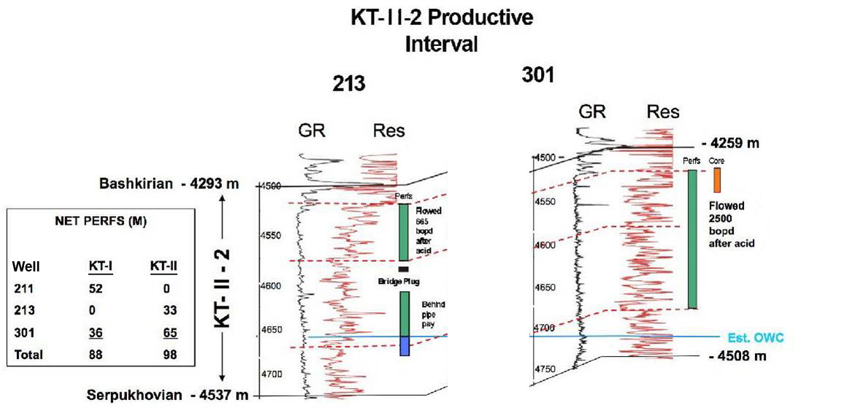
“ Well 308”
Reason for confidence “Location and Geology”
The two producing wells are 1.1 km apart
EZ# 308 to be drilled in between
Gross pay of K-II horizon is some 420 metres
Net pay in the EZ# 213 well is 33 metres
Net pay in the EZ# 301 well is 65 metres
TSX: CEK.TO
WWW.CASPIANENERGYINC.COM

Slide 13
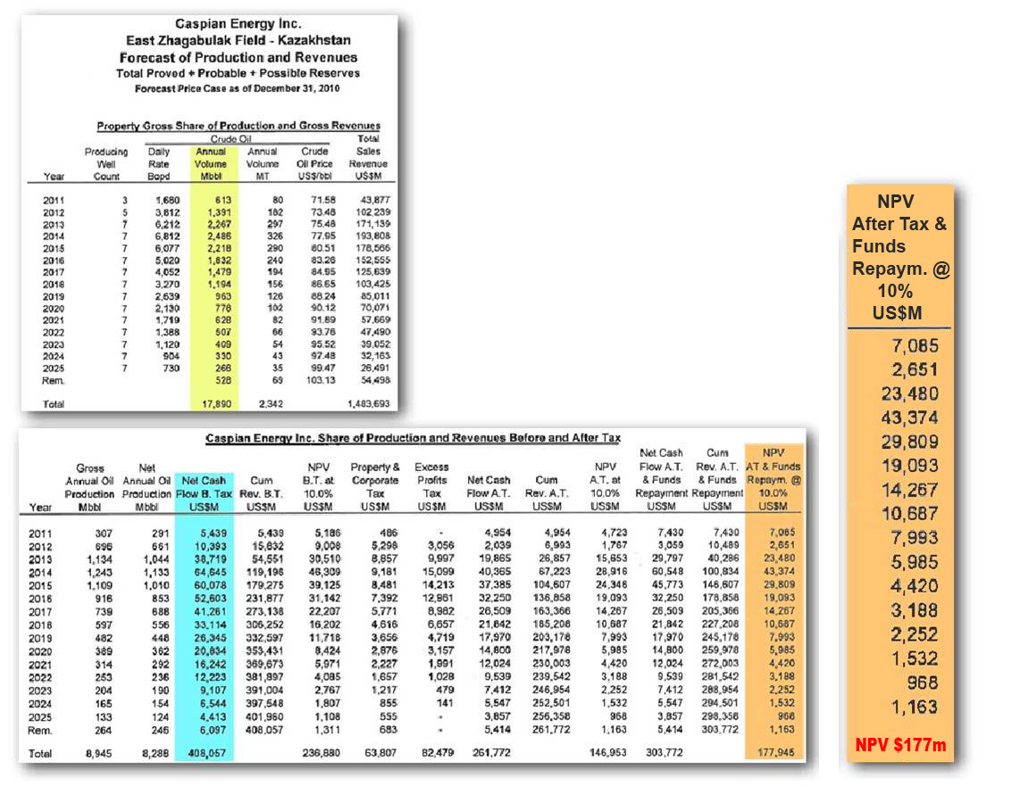
East Zhagabulak “Not a Huge Field But it Has Significant Value for Caspian”
Net cash flow to Caspian
is $408 million
Net Present Value of Caspian
is 94¢ /share
NET to Caspian
by McDaniels
TSX: CEK.TO
WWW.CASPIANENERGYINC.COM

Slide 14
East Zhagabulak - Value Sensitivity to Brent Price
Various Brent Scenarios After Tax (us$mln)
$100 Brent (10% discount) | Caspian’s 40% Share | $114 Brent (10% discount) | Caspian’s 40% Share
157.7 mln |  | 184.0
181.2 |  | 206.1
339.0 | $135.6mln | 390.2mln | $156.1 mln
Proved + Probable Reserves
Possible Reserves
Proved + Probable + Possible Reserves
Per Share 61 cents 70 cents
TSX: CEK.TO
WWW.CASPIANENERGYINC.COM

Slide 15
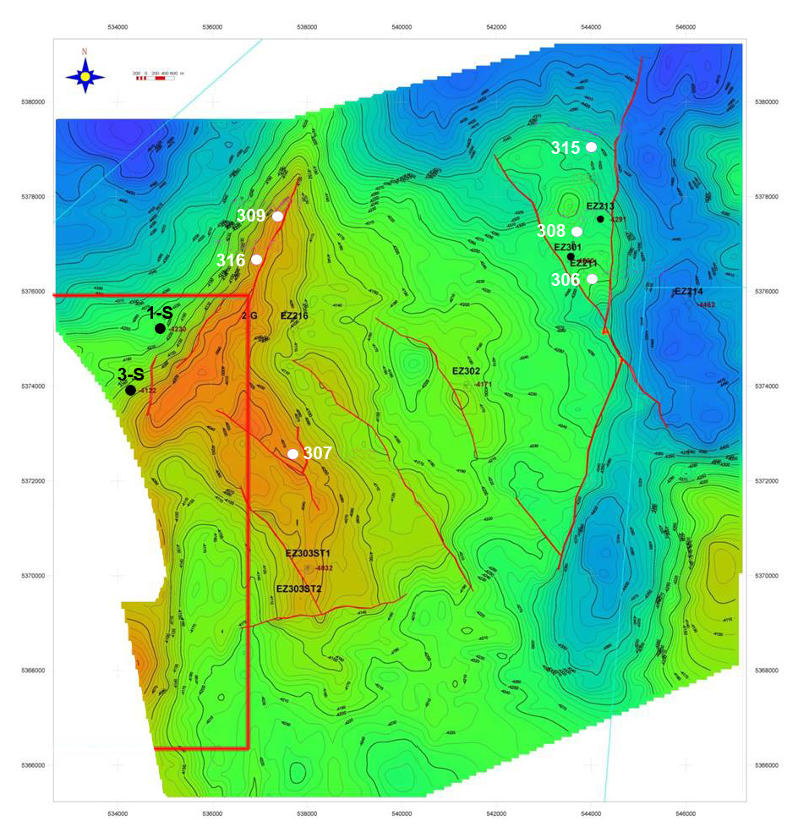
West Zhagabulak
East Zhagabulak
- Structure -
1. Twice the size of
East Zhagabulak?
2. +200m updip v’s EZ
3. Akmai drilled S1 + S3
4. Sakramabas S1 + S3
both successful
3-D seismic Re-processed/re-interpreted by uniwe-beijing
KT – II2 Top Scale = 1 : 100,000
TSX: CEK.TO
WWW.CASPIANENERGYINC.COM
Notes:
15
As of now, we’ve drilled two successful wells in the East Zhagabulak field and on the strength of that success, we hold a 25 year production licence for that field, represented on our map as the dark red EZ block. Those wells are now producing a combines total of about 470 barrels of oil per day.
We’re also midway through a three-year exploration licence for the entire grey area, some 1,500 acres called the North Block.
And the North Block is located in West Central Kazakhstan, very near a major oil transmission corridor, so we have ready access to transportation for production volumes well in excess of our current totals.
Despite all this, we were badly delayed in executing our developments plans because of the need of a new partner with deeper pockets.
Fortunately, we found that partner late last year and we are now back in action. In addition to cash strength, our new partner brings a wealth of technical expertise. Taken all together this means that we’re in a very much better position to assess seismic data, drill wells and produce oil than we were a few months ago.

Slide 16
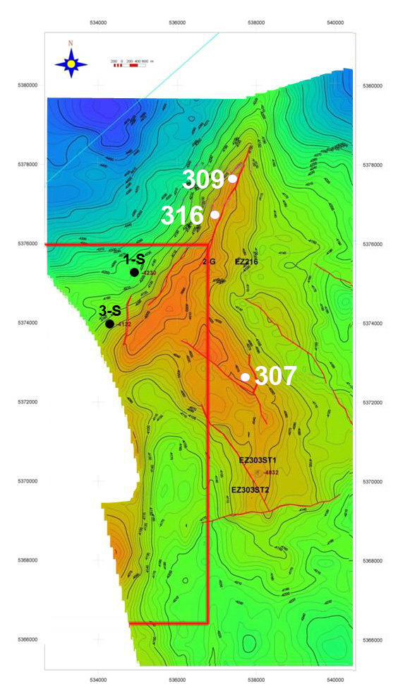
West Zhagabulak/ Sakramabas
We spudded 316 26 July
Shared structure with AKMAI (“them”)
AKMAI Sakramabas Gov’t (E) C1/C2 reserves 50mmbls
APC share = AKMAI share of structure
“Our” Wells 309 & 307 already approved
Success → at 316 move first rig to 309 (E Feb)
Success → at 316 move second rig to 307 (E Apr)
“them”
TSX: CEK.TO
WWW.CASPIANENERGYINC.COM

Slide 17
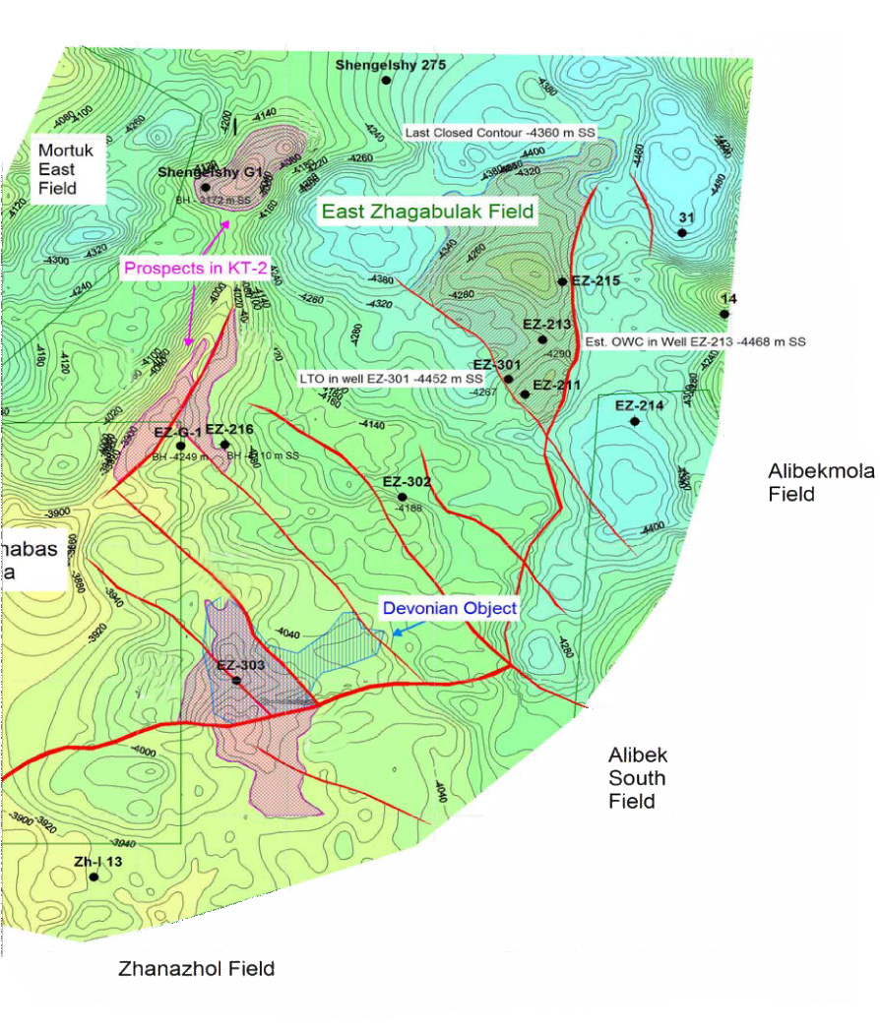
Greater Zhagabulak
“Connected or Independent Prospects?”
McDaniels “sees” five prospects
 | P-50 P-10
Total | 26.9 85.1 mm bls
East Zhagabulak
“Drilling Now”
100% APC, Capital, Risking, McDaniel Model, Opex, Price Deck
TSX: CEK.TO
WWW.CASPIANENERGYINC.COM

Slide 18
Work Program 2012
2012
February
January
March
April
May
June
July
August
Septem
October
November
December
Well 308
Paperwork
TEST
TEST
TEST
TEST
TEST
TEST
TEST
TEST
TEST
Well 306
Drilling
Drilling
Drilling
Drilling
Paperwork
TEST
TEST
TEST
TEST
TEST
TEST
Well 315
Drilling
Drilling
Drilling
Drilling
Paperwork
TEST
TEST
TEST
2 Rig
Well 316
Drilling
Paperwork
TEST
TEST
TEST
TEST
TEST
TEST
Well 309
Drilling
Drilling
Drilling
Drilling
Paperwork
TEST
TEST
TEST
TEST
3 Rig
Well 307
Drilling
Drilling
Drilling
Drilling
Drilling
Paperwork
TEST
TEST
TEST
MP
Well # XY
Drilling
Drilling
Drilling
Drilling
Paperwork
TEST
TEST
TSX: CEK.TO
WWW.CASPIANENERGYINC.COM

Slide 19
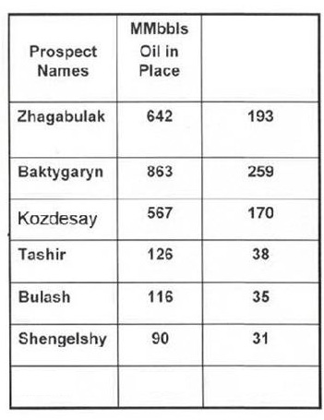
“Leads Beyond Greater Zhagabulak”
Leads
Leads
TSX: CEK.TO
WWW.CASPIANENERGYINC.COM

Slide 20
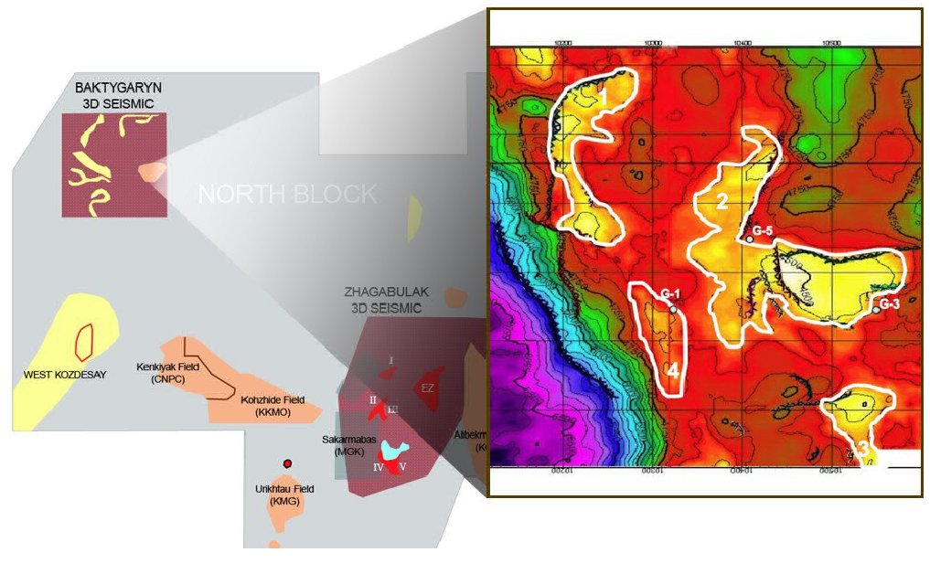
Baktygaryn
Extensive channel sands
Several bright spots on 3-D seismic
Triassic P50 case — 44 million barrels
Triassic P10 case — 129 million barrels
Carboniferous P50 case — 30 million barrels
Carboniferous P10 case — 100 million barrels
▪
▪
▪
▪
▪
▪
TSX: CEK.TO
WWW.CASPIANENERGYINC.COM

Slide 21
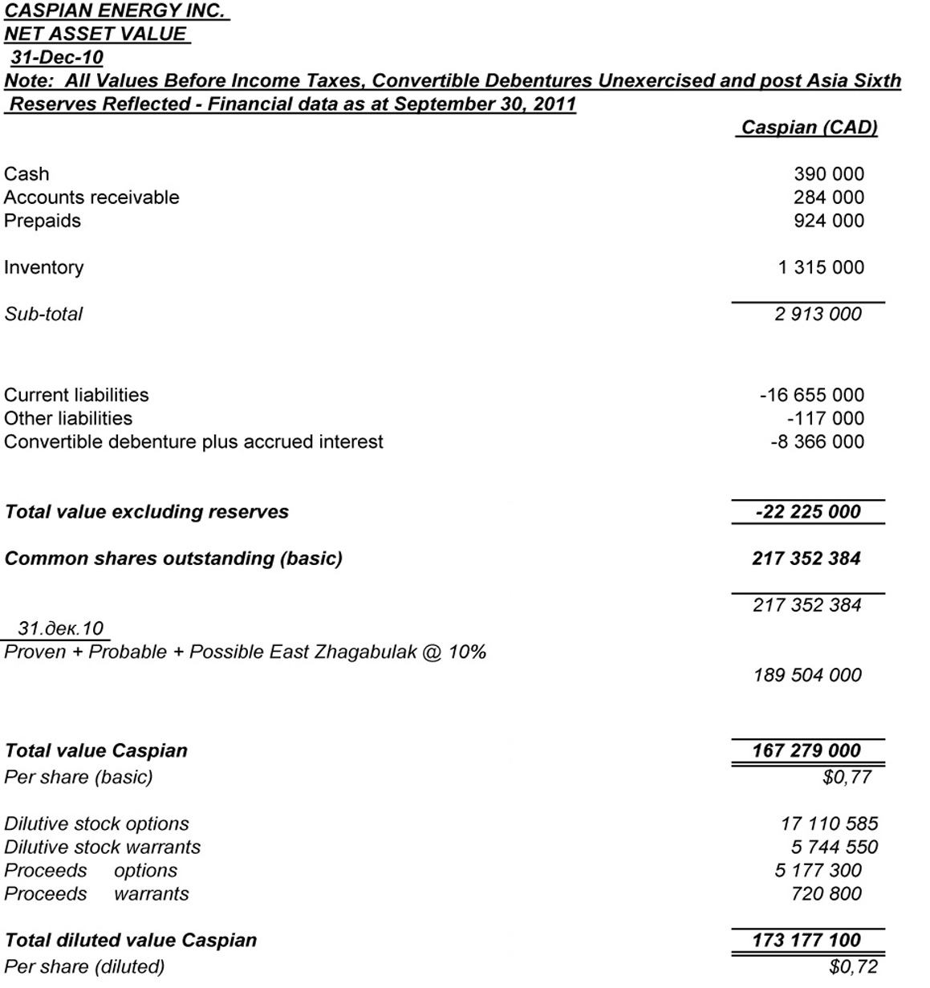
V’s Todays m/kt price Cd$ 0.23
TSX: CEK.TO
WWW.CASPIANENERGYINC.COM

Slide 22
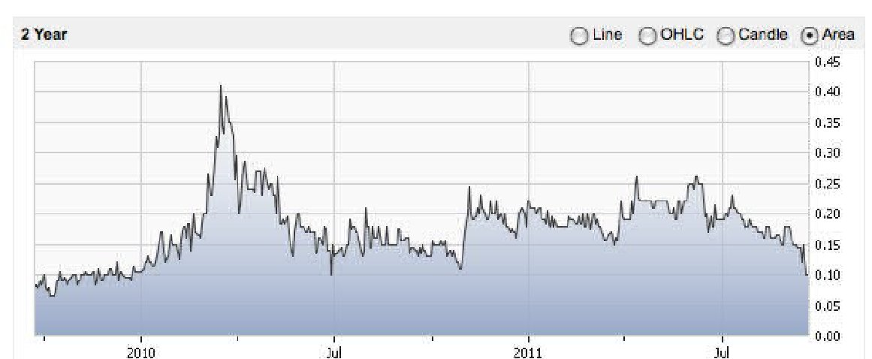
Caspian Share Price History (2 yr)
APC - Asia Sixth
Deal first announced
Shares outstanding ( 30 Sept.) : 217.25 million
Recent Share Price Cad$ 0.23 cents
TSX: CEK.TO
WWW.CASPIANENERGYINC.COM

Slide 23
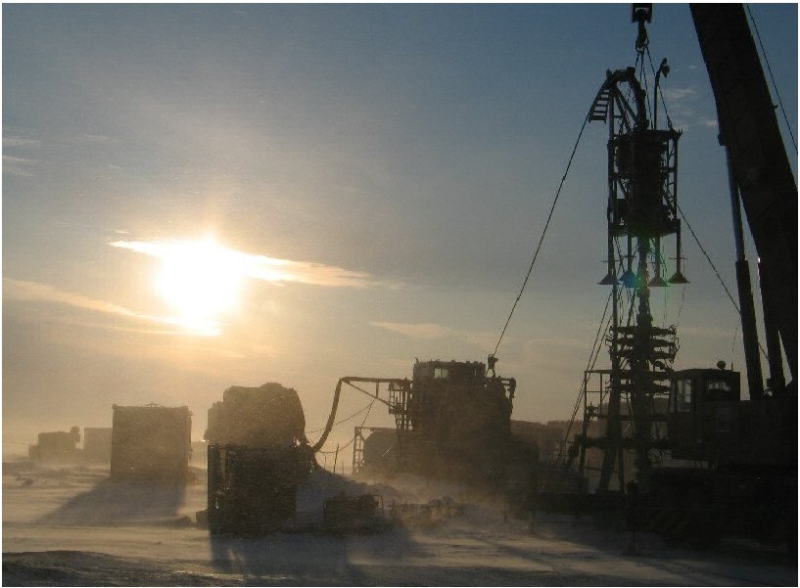
Why Caspian
New Management,
New Direction
Caspian Carried for $80ml of capex
Established Production
Well 308, Operational Transformation “Looking Good”
“North Block” Exploration Potential
Well 316, A New Discovery??
Share price undervalued
TSX: CEK.TO
WWW.CASPIANENERGYINC.COM

Slide 24
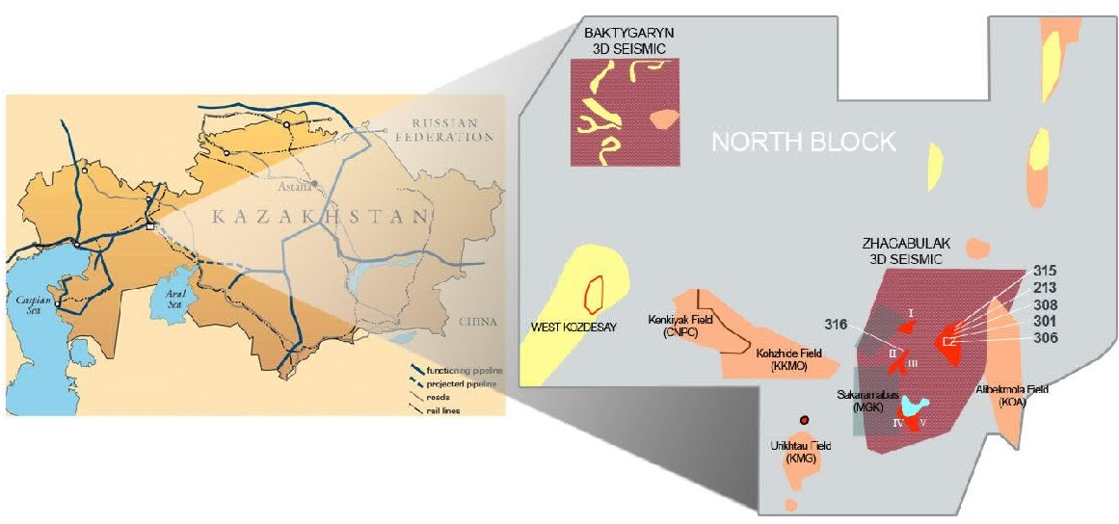
Connections to Market
All target areas near to pipeline
KTO access via S. Alibekmola
Oil Quality: API 39
Export Price: Brent minus us$10 per barrel
Samara
Russia
Atyrau
TSX: CEK.TO
WWW.CASPIANENERGYINC.COM

Slide 25
Aral y-t-d Daily Oil Production 2011
BoPD
Total Production
(301 + 213)
Well 301 - Production started on June 15, 2011
Natural flow
Well 213 - Production started on June 16, 2011
New Submersible pump installed
Realised
Price per – us$102.3 | us$105.6 | us$92.37 | us$99.43 | us$99.90 | us$92.71
Barrel
TSX: CEK.TO
WWW.CASPIANENERGYINC.COM

Slide 26
Reasons for Confidence
“The Carboniferous Trend is well known”
AA’
EAST
A
WEST
K e n k iy a k
M o rtu k
E a s t Z h a g a b u la k
A lib e k m o la
K
J
T
0
1
C
2 -3
C
1
P 2
P 2
P 2
D
3
P 2
2
3
4
D
1 -2
P 1 k
P 1 -C
3
5
C
2
C
D
1
1 -2
6
7 км
D
3
L egend
Note: all oil deposit areas depicted here are notional.
P r e -S a lt L im e s to n e s
TSX: CEK.TO
WWW.CASPIANENERGYINC.COM

